Slide 1
Lab meeting
09/12/25

Slide 2
Work in progress
The role of 4EBP in Apc-Ras (AR) tumour growth
Effect of diet on tumour growth/invasion
Trametinib/Selumetinib pharmokinetics

Slide 3
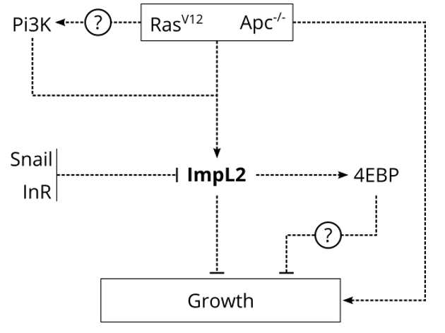
2. The role of 4EBP in Apc-Ras (AR) tumour growth

Slide 4
2. The role of 4EBP in Apc-Ras (AR) tumour growth
S6K
FOXO
ATF4
P
4EBP
4EBP
EIF4E
EIF4E
Blocks cap-dependent translation
Allows cap-dependent translation

Slide 5
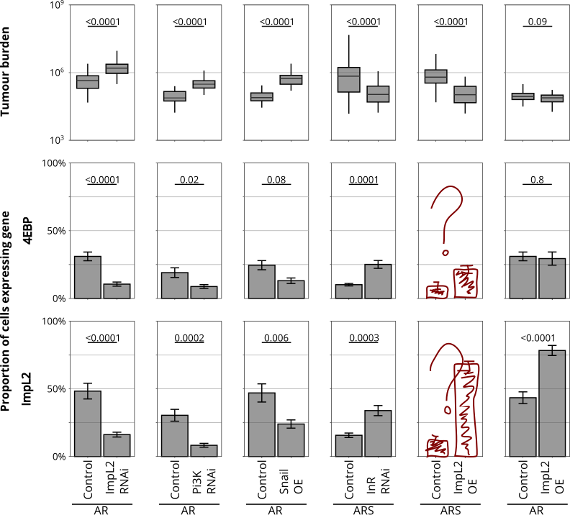
2. The role of 4EBP in Apc-Ras (AR) tumour growth

Slide 6
2. The role of 4EBP in Apc-Ras (AR) tumour growth
To do:
Look at effect on tumour growth of knocking down and overexpressing 4EBP.
Look at ImpL2 expression levels when knocking down and overexpressing 4EBP.
Look at levels of 4EBP/p4EBP when knocking down ImpL2.
Look at effect of knocking down ATF4 on tumour growth/ImpL2 expression/4EBP expression.

Slide 7
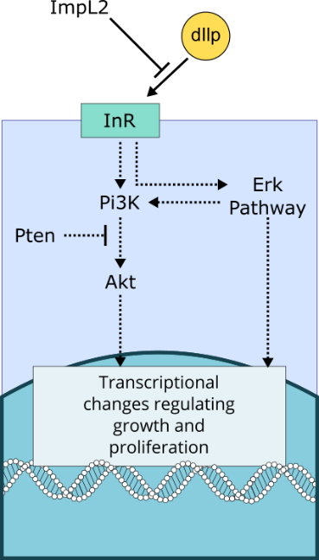
2. Effect of diet on tumour growth/invasion

Slide 8
2. Effect of diet on tumour growth/invasion
Questions:
1) Does genotype affect tumour growth/invasion (we know it does)?
2) Does diet affect tumour growth/invasion?
3) Is there an interaction between genotype/diet on tumour growth/invasion?
Three genotypes:
AR
AR ImpL2 RNAi
AR Snail OE
Three diets:
Control
High calorie (x2 sugar)
High protein (x2 yeast)
12 repeats, each of 12 flies from each genotype on each food.
(previously done with 3 repeats, each of 24 flies from each genotype on each food)

Slide 9
2. Effect of diet on tumour growth/invasion
Questions:
1) Does genotype affect tumour growth/invasion (we know it does)?
2) Does diet affect tumour growth/invasion?
3) Is there an interaction between genotype/diet on tumour growth/invasion?
Three options for stats:
2-way ANOVA
easy to interpret
assumes normality of residuals and homogeneity of variances, which may be optimistic
still a possibility if data meets assumptions
Linear mixed model
more powerful and takes into account all the results
but harder to do and not as intuitive to interpret
still assumes ~normal residuals
Kruskal-Wallis on each genotype
Non-parametric – an option if data has excessively heterogenous variances/is very not normal
I wouldn’t be able to statistically test for an interaction between diet and genotype.

Slide 10
2. Effect of diet on tumour growth/invasion
Questions:
1) Does genotype affect tumour growth/invasion (we know it does)?
2) Does diet affect tumour growth/invasion?
3) Is there an interaction between genotype/diet on tumour growth/invasion?
To do:
Do repeat 6.
Test (/work out how to do) stats.
(Maybe) do repeat 7-12.
Depending on results, further experiments to test in changes in growth due to diet may be due to changes in ImpL2 expression.

Slide 11
3. Trametinib/Selumetinib pharmokinetics
Trametinib and selumetinib are both chemotherapies that act as MEK (MAPKK) inhibitors.
In our model, trametinib reduces tumour growth and invasion but selumetinib doesn’t.
Can we measure their pharmokinetics (steady state concentration/half life)?
How does this correlate with pharmokinetics in mammals?
Could this explain why selumetinib does not have an effect?

Slide 12
3. Trametinib/Selumetinib pharmokinetics
We’re using mass spec to look at Trametinib concentrations.
Following treatment, we can detect trametinib in fly guts and in flies without guts.
Put on food
Take off food
2 days
4 days
7 days on Trametinib food
1 day
3 days
5 days

Slide 13
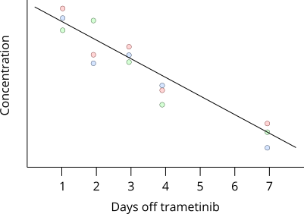
3. Trametinib/Selumetinib pharmokinetics
We’re using mass spec to look at Trametinib concentrations.
Following treatment, we can detect trametinib in fly guts and in flies without guts.

Slide 14
3. Trametinib/Selumetinib pharmokinetics
To do:
Get results.
Repeat if it doesn’t work.
Opposite experiment – build up to steady state values.
Test with selumetinib.
Test with ARS flies.
Use Erk reporter lines to look at changes in Erk activity over time in AR/ARS flies.

